Slide 1

End Sem Project Presentation
Skin Lesions Classification Using
Deep-learning
Team No: E-15
Presented to
Dr.Rimjhim Padam Singh
P.Dinesh Saravan BL.EN.U4AIE21099
M.Sai Subhash BL.EN.U4AIE21113
S.Venkata Mahesh BL.EN.U4AIE21117

Slide 2
Outline
Problem Statement
Introduction
Dataset Description
Implementation
Results and Analysis
Conclusion and Future Work
References

Slide 3
Problem Statement
Traditional methods of diagnosing skin lesions, such as visual examination by dermatologists and biopsy, can be time-consuming, subjective, and prone to human error.
The goal of this project is to develop a robust, automated deep learning model that can accurately classify skin lesions from dermoscopic images into different categories (e.g., benign or malignant). This model aims to assist dermatologists in making faster and more accurate diagnoses, thereby improving patient outcomes and optimizing healthcare resources.

Slide 4
Introduction
Traditional methods of identifying these diseases involve a lot of time and hard work.
One of the biggest challenges is obtaining high-quality and diverse data
Early detection enabled by deep learning models can improve patient outcomes and reduce healthcare costs.
The use of deep learning for skin lesion classification marks a significant breakthrough in dermatological diagnostics.

Slide 5
Introduction
AI models are trained on vast image datasets to recognize various skin diseases by analyzing patterns and characteristics.
Classifications involve using advanced artificial intelligence (AI) to identify and categorize skin blemishes based on images.
Extracting image features and learning intricate patterns within lesions.
Leveraging the power of convolutional neural networks (CNNs) and extensive datasets, these technologies promise early, accurate, and widely accessible detection of skin lesions.

Slide 6
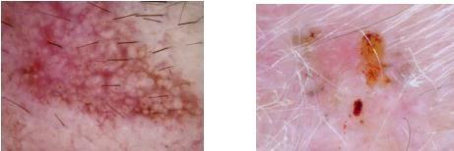
Dataset Description
The ISIC 2019 dataset comprises over 2,500 dermoscopic images categorized into 8classes, including melanoma, benign nevi, and other skin conditions.
It offers two challenging tasks:
Classifying images based solely on visual features or incorporating additional metadata.
To facilitate model evaluation during the challenge, a separate validation set is provided.
The dataset is in JPEG format, with EXIF data removed to eliminate camera setting biases.
Additionally, it includes segmentation masks that demarcate specific lesions
within each image, aiding in the analysis and understanding of skin conditions.
actinic keratosis
basal cell carcinoma

Slide 7
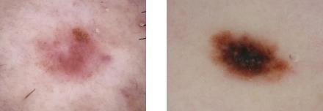
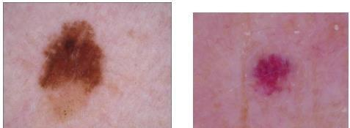
Dataset Description
According to the ISIC 2019 data, skin lesions
can be divided into 8 categories:
1. Melanoma
2. Melanocytic Nevus
3. Basal Cell Carcinoma
4. Actinic Keratosis
5. Benign Keratosis
6. Dermatofibroma
7. Vascular Lesion
8. Squamous Cell Carcinoma.
Melanoma
pigment benign keratosis
nevus
dermatofibroma

Slide 8
IMPLEMENTATION
Data Augmentation and Preprocessing:
Split the dataset into training, validation and testing sets.
Model Selection:
We have choosen an DenseNet201 deep learning model as a base
3. Model Training:
Train the model on the training dataset.

Slide 9
IMPLEMENTATION
Model Evaluation:
Calculate metrics such as accuracy, precision, recall, and F1 score.
Confusion Matrix and Visualization:
Generate a confusion matrix to understand the model's performance on each class.
Save and Deploy:
Save the trained model for future use.

Slide 10
IMPLEMENTATION
These are the layers we have added in DenseNet201 :
Dense(512, activation='relu')
Dense(256, activation = ‘relu’)
Dense(128, activation = ‘relu’)
Dense(64, activation='relu')

Slide 11
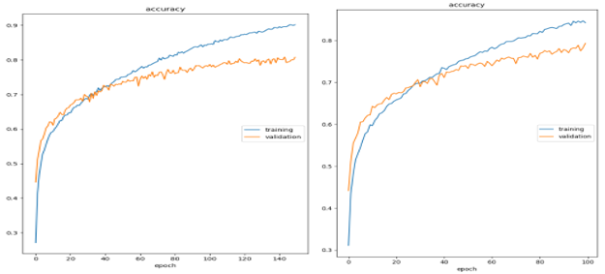
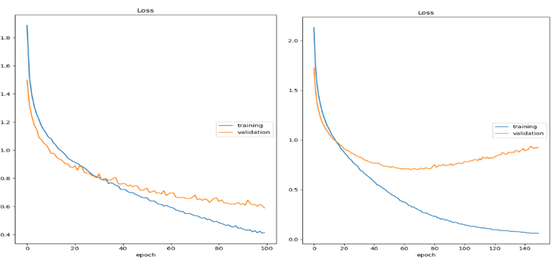
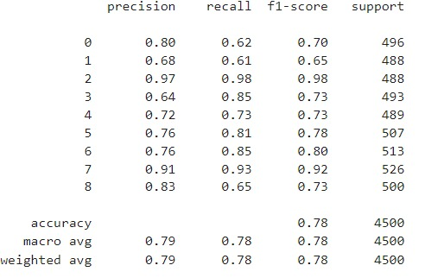
Result and analysis
Dense(512, activation = ‘relu’)
Dense(256, activation = ‘relu’)
Dense(128, activation = ‘relu’)
Dense(64, activation = ‘relu)

Slide 12
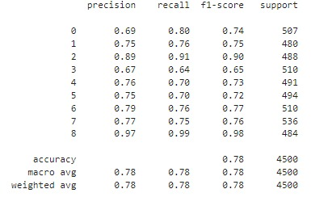
Result and analysis
Dense(512, activation = ‘relu’)
SeqSelfAttention(attention_activation='sigmoid')
Dense(256, activation = ‘relu’)
Dense(128, activation = ‘relu’)
Dense(64, activation = ‘relu)

Slide 13
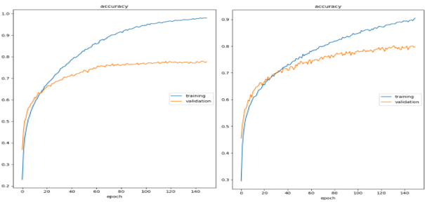
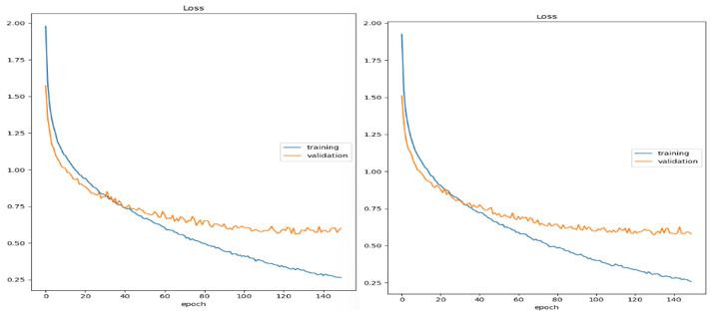
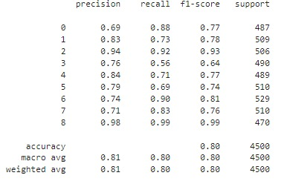
Result and analysis
Dense(512, activation = ‘relu’)
Dense(256, activation = ‘relu’)
SeqSelfAttention(attention_activation='sigmoid')
Dense(128, activation = ‘relu’)
Dense(64, activation = ‘relu’)

Slide 14
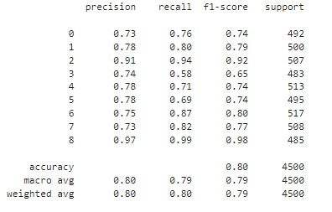
Result and analysis
Dense(512, activation = ‘relu’)
Dense(256, activation = ‘relu’)
Dense(128, activation = ‘relu’)
SeqSelfAttention(attention_activation='sigmoid')
Dense(256, activation = ‘relu’)

Slide 15
Result and analysis
Models | Loss
 | Train | Validation | Test
DenseNet201 | 0.19 | 0.58 | 0.61
DensenNet Layer (1,2) | 0.01 | 0.92 | 0.94
Dense Net Layer (2,3) | 0.1 | 0.6 | 0.6
Dense Net Layer (3,4) | 0.09 | 0.57 | 0.59
Models | Precision | Recall | F1_Score | accuracy
DenseNet201 | 0.78 | 0.78 | 0.77 | 0.78
DensenNet Layer (1,2) | 0.77 | 0.77 | 0.77 | 0.77
DenseNet Layer (2,3) | 0.8 | 0.8 | 0.8 | 0.8
Dense Net Layer (3,4) | 0.79 | 0.79 | 0.79 | 0.79
Models | Accuracy
 | Train | Validation | Test
DenseNet201 | 0.94 | 0.79 | 0.78
DensenNet Layer (1,2) | 0.99 | 0.77 | 0.77
Dense Net Layer (2,3) | 0.96 | 0.8 | 0.8
Dense Net Layer (3,4) | 0.97 | 0.79 | 0.79

Slide 16
Conclusion and Future Work
Our Study on skin lesion classification using deep learning across 8 classes has proven the efficiency of different deep learning models including MobileNetV2, DenseNet201, VGG-16, ResNet-152, InceptionResNetV2: DenseNet201 performing best among all of these.
DenseNet201’s F1-Score was increased by introducing extra layers of self-attention between dense layers, yielding further additional degrees of classification accuracy.
This work proves that the adoption of self-attention mechanism in DenseNet201 is a valuable solution for skin lesions classifications and serves as a valuable contribution to medical imaging and dermatology diagnostics.
Future work involves exploring advanced neural network architectures beyond DenseNet201, expanding datasets for greater diversity, developing real-time applications for accessible dermatological care, conducting clinical validation trials, and enhancing model interpretability through explainable AI techniques.

Slide 17
References
[1] Kassem, M.A., Hosny, K.M. and Fouad, M.M.,2020. Skin lesions classification into eight classes for ISIC 2019 using deep convolutional neural network and transfer learning. IEEE Access, 8, pp.114822-114832.
[2] Gouda, N. and Amudha, J., 2020, October. Skin cancer classification using ResNet. In 2020 IEEE 5th International Conference on Computing Communication and Automation (ICCCA) (pp. 536-541). IEEE.
[3] Shrinithi, S. and Aravinth, J., 2021, August. Detection of Melanoma Skin Cancer using Dermoscopic Skin Lesion Images. In 2021 International Conference on Recent Trends on Electronics, Information, Communication & Technology (RTEICT) (pp. 240-245). IEEE.
[4] Kumar, R.P., Venkatraman, K., Jawahar, C., Harish, B., Bharathraj, S. and Mukesh, K., 2023, November. Attention-Guided Residual Network for Skin Lesion Classification Using Deep Reinforcement Learning. In 2023 International Conference on Integrated Intelligence and Communication Systems (ICIICS) (pp.1-7). IEEE.
[5] Aishwarya, N., Prabhakaran, K.M., Debebe, F.T., Reddy, M.S.S.A. and Pranavee, P., 2023. Skin Cancer Diagnosis with Yolo Deep Neural Network. Procedia Computer Science, 220, pp.651-658.

Slide 18
References
[6] Kadirappa, R. and Ko, S.B., 2023. An automated multi-class skin lesion diagnosis by embedding local and global features of Dermoscopy images. Multimedia Tools and Applications, pp.1-28.
[7] Azeem, M., Kiani, K., Mansouri, T. and Topping, N., 2023. SkinLesNet: Classification of Skin Lesions and Detection of Melanoma Cancer Using a Novel Multi-Layer Deep Convolutional Neural Network. Cancers, 16(1), p.108.
[8] Alsahafi, Y.S., Kassem, M.A. and Hosny, K.M.,2023. Skin-Net: a novel deep residual network for skin lesions classification using multilevel feature extraction and cross-channel correlation with detection of outliers. Journal of Big Data, 10(1), p.105.
[9] Sivakumar, M.S., Leo, L.M., Gurumekala, T., Sindhu, V. and Priyadharshini, A.S., 2023. Deep learning in skin lesion analysis for malignant melanoma cancer identification. Multimedia Tools and Applications, pp.1-21.
[10] Bozkurt, F., 2023. Skin lesion classification on dermatoscopic images using effective dataaugmentation and pre-trained deep learning approach. Multimedia Tools and Applications, 82(12), pp.18985-19003.

